Slide 1

Flick Stick
An Android Mobile Soccer Game
Anthony Menjivar
January 21, 2015

Slide 2
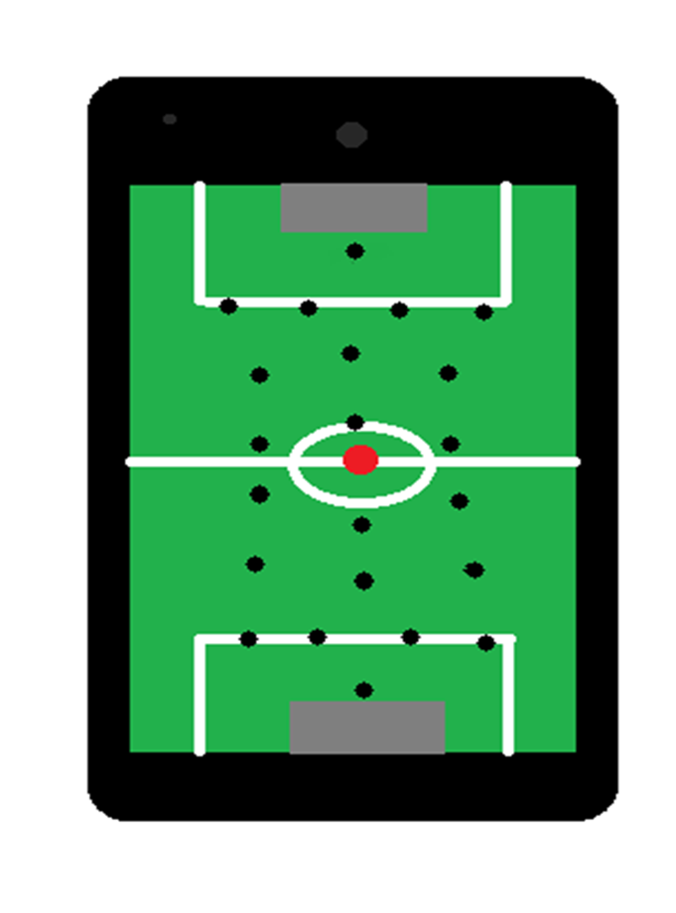
Flick Stick Description
Layout
Soccer Field
22 sticks (11 on each side)
Pre-Determined Formation
Obstacles

Slide 3
Flick Stick Description
Game Play
2 players (1v1, 1vRobot, 1vOnline)
1st player flicks ball from starting point towards goal to score
Players take turns flicking the ball
First to certain amount of goals wins
Audience
Anyone that knows how to use a phone or tablet and can play games

Slide 4
Justification
Challenging Project
Draws upon Knowledge from Previous Classes
With Research still needed, should be semester long project
Mobile Video Games are big
Soccer + Video Games

Slide 5
User’s View

Slide 6
Operations Description
Game Play (previous)
Menus
Online Play
Still researching

Slide 7
Technologies
Hardware
Windows 8.1 PC
Google Nexus 5 with Android 5.0 Lollipop
Android Studio Bundle
Official Integrated Development Environment (IDE) for android
Graphics User Interface (GUI) access
Android Software Development Kit
Java
Java Game Development Framework
XML
Create Layouts and the GUI representation

Slide 8
Game Inspiration

Slide 9
Preliminary Schedule
Week 3 – Preliminary Research
Week 4 – Layouts & Sprites Drawn out

Slide 10
Preliminary Schedule
Week 3 – Preliminary Research
Week 4 - Java
Week 6 – Layouts & Sprites Drawn out & Coded
Week 8 – Match Aspect of the Game implemented
Week 13 – Have First Implementation of Game for testing
Week 16 – Testing Finished and Game Finished

Slide 11
Conclusion

Slide 12
Questions?

